Slide 1

Read alignment
Presented by:
Ximena Ibarra-Soria
GSK
ximena.x.ibarra-soria@gsk.com
@xIbarraSoria
Based on materials by:
Anthony Doran and Vivek Iyer
Next Generation Sequencing Bioinformatics Course
22-27 January 2023 – Santiago, Chile
FACULTAD DE
CIENCIAS BIOLOGICAS
PONTIFICIA UNIVERSIDAD CATÓLICA DE CHILE

Slide 2
NGS read alignment
Introduction to read alignment.
Main methods and aligners.
Visualisation of aligned reads.
NGS workflows, QC and BAM improvement.

Slide 3
NGS read alignment
Introduction to read alignment.
Main methods and aligners.
Visualisation of aligned reads.
NGS workflows, QC and BAM improvement.

Slide 4
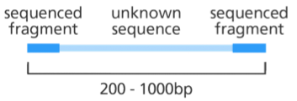
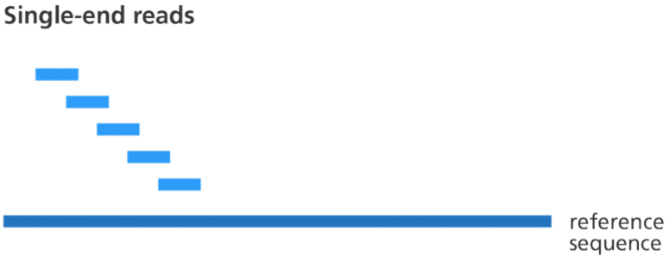
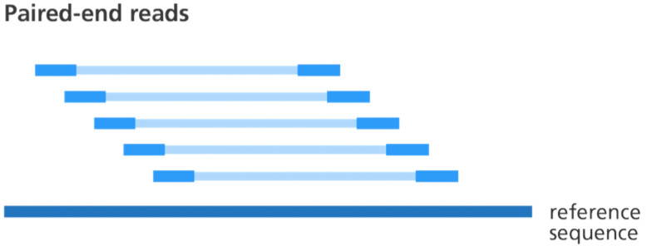
NGS read alignment
Next generation sequencing (NGS) generates millions of short reads.
Read alignment is the process of determining the most likely source of the read within a reference genome sequence.
Image credit: Genome Research Limited
Flicek and Birney, Nat. Methods 6 (2009) doi.org/10.1038/nmeth.1376

Slide 5
NGS read alignment
Next generation sequencing (NGS) generates millions of short reads.
Read alignment is the process of determining the most likely source of the read within a reference genome sequence.
Challenges:
Millions of short reads.
Very large search space.
Need to allow mismatches/indels (both PCR and sequencing errors; variation).
Flicek and Birney, Nat. Methods 6 (2009) doi.org/10.1038/nmeth.1376

Slide 6






Reference genomes
1998
2000
2001
2002
2004
2005
Reference genomes of model organisms were generated using Sanger sequencing.
Collaborative projects involving many institutes from different countries.
Sequencing and assembly.
Curation and annotation.
Distribution.
Initially done by NCBI.
Taken over by the Genome Reference Consortium.

Slide 7
Reference genomes
human
mouse
Release name | Date of release | UCSC equivalent
GRCh38 | Dec 2013 | hg38
GRCh37 | Feb 2009 | hg19
NCBI Build 36.1 | Mar 2006 | gh18
NCBI Build 35 | May 2004 | hg17
NCBI Build 34 | Jul 2003 | hg16
Release name | Date of release | UCSC equivalent
GRCm39 | Jun 2020 | mm39
GRCm38 | Dec 2011 | mm10
NCBI Build 37 | Jul 2007 | mm9
NCBI Build 36 | Feb 2006 | mm8
NCBI Build 35 | Aug 2005 | mm7
Reference genomes are constantly improved.
When additional sequence becomes available to close gaps a new assembly is released.
Alignment results depend on the assembly used (coordinates change).

Slide 8
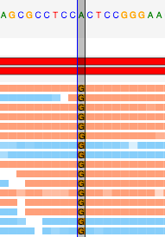
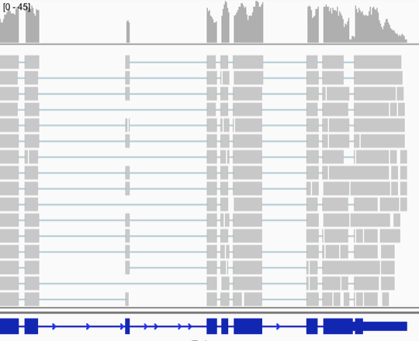
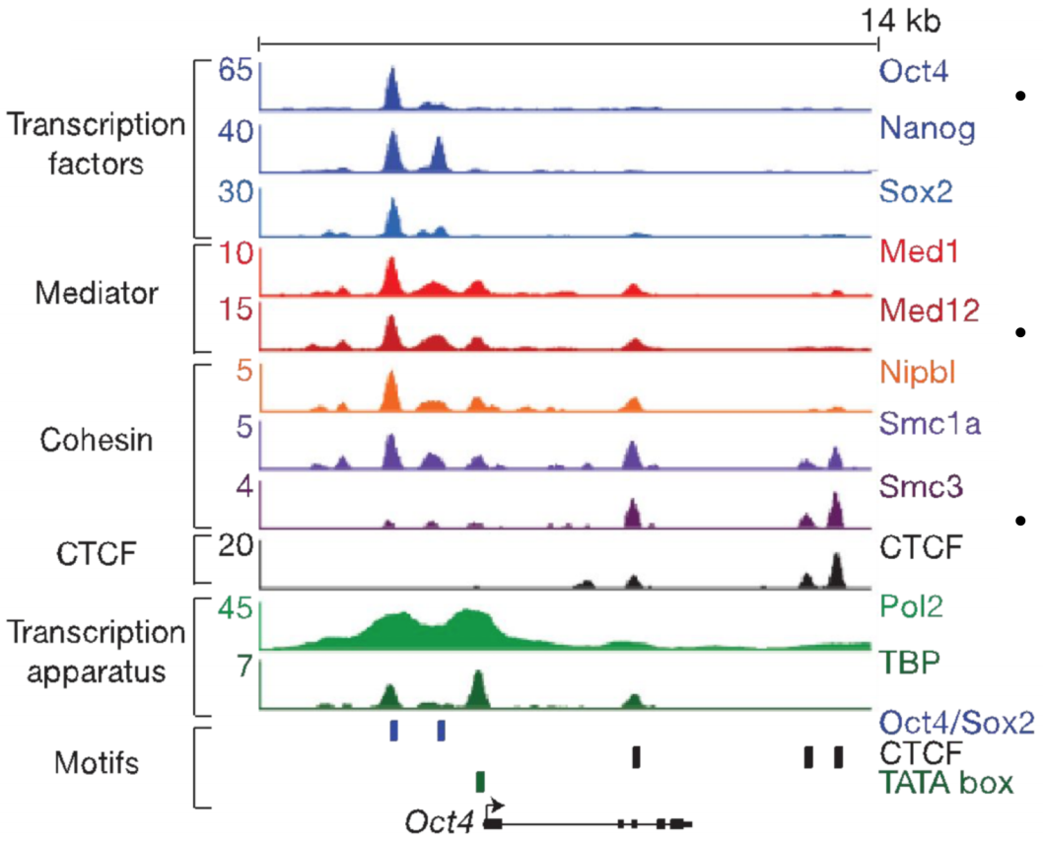
Why do we need to align reads
Image credit: Genome Research Limited
identify variation
measure transcript abundance
identify regions bound by TFs

Slide 9
NGS read alignment
Introduction to read alignment.
Main methods and aligners.
Visualisation of aligned reads.
NGS workflows, QC and BAM improvement.

Slide 10
Smith-Waterman algorithm (1981)
Algorithm to identify the optimal pairwise alignment between two sequences.
optimal = the most correspondences and least differences
Pairwise comparisons between letters are scored based on a substitution matrix and gap penalties.
High sensitivity but slow.
Notes:
It is not practical to use it to align millions of reads.
But it is used to refine a quick approximate placement.
And variant callers might use it to correctly re-align reads with insertions/deletions

Slide 11
Smith-Waterman algorithm (1981)
For example, if we have the following sequences we can align them by eye.
REFERENCE SEQUENCE:
ATCG
QUERY SEQUENCES:
ATG
ALIGNMENT:
ATCG
|| |
AT-G
Traverse the grid. Moving
- diagonally match/mismatch
- horizontally/vertically gap
ACCG
ALIGNMENT:
ATCG
||||
ACCG
 | A | T | C | G
A
T
G
 | A | T | C | G
A
C
C
G

Slide 12
Smith-Waterman algorithm (1981)
 |  | A | T | C | G
 | 0 | 0 | 0 | 0 | 0
A | 0
T | 0
G | 0
Scoring:
- match +3
- mismatch -3
- gap -2
Enter each cell and score, adding to the previous cell score.
Retain the largest score* along with the entry point that generated it.
-2,-2,3
3
1,-2,-3
1
-1,-2,-3
-1=0
-2,-2,-3
-1=0
-2,1,-3
1
Enter a cell:
- from the left
- from the top
- from diagonal - match/mismatch
gap
* If largest score is negative replace with 0.

Slide 13
Smith-Waterman algorithm (1981)
 |  | A | T | C | G
 | 0 | 0 | 0 | 0 | 0
A | 0 | -2,-2,3 3 | 1,-2,-3 1 | -1,-2,-3 -1=0 | -2,-2,-3 -1=0
T | 0 | -2,1,-3 1 | -1,-1,6 6 | 4,-2,-2 4 | 2,-2,-3 2
G | 0 | -2,-1,-3 -1=0 | -2,4,-2 4 | 2,2,3 3 | 1,0,7 7
Scoring:
- match +3
- mismatch -3
- gap -2
Enter each cell and score, adding to the previous cell score.
Retain the largest score* along with the entry point that generated it.
Enter a cell:
- from the left
- from the top
- from diagonal - match/mismatch
gap
* If largest score is negative replace with 0.

Slide 14
Smith-Waterman algorithm (1981)
 |  | A | T | C | G
 | 0 | 0 | 0 | 0 | 0
A | 0 | -2,-2,3 3 | 1,-2,-3 1 | -1,-2,-3 -1=0 | -2,-2,-3 -1=0
T | 0 | -2,1,-3 1 | -1,-1,6 6 | 4,-2,-2 4 | 2,-2,-3 2
G | 0 | -2,-1,-3 -1=0 | -2,4,-2 4 | 2,2,3 3 | 1,0,7 7
To find the optimal alignment:
- Start at the highest scoring cell.
- Traceback the alignment with the longest score.
Entry from left or top = gap.
Entry from diagonal = match/mismatch.
A
|
A
T
|
T
C
|
-
G
|
G

Slide 15
Alignment of NGS data
Challenges of aligning NGS data:
There are tens to hundreds of millions of sequencing reads to be mapped.
The search space (reference genome) can be very large.
Human haploid genome: 3,234.83 Mb
Mouse haploid genome: 2,653.99 Mb
Notes:
To address the large input size problem (millions of reads and a large reference):
Filtering: quickly exclude large reference regions where matches cannot be found.
Take a substring of the read (seed) and find perfect matches.
Indexing: involves pre-processing the reference to speed-up matching without scanning the whole reference.
Hash tables.
Suffix trees.
FM indices with Burrows-Wheeler transform.

Slide 16
Alignment of NGS data
Solutions to these problems use two basic principles.
Filtering: quickly exclude large regions of the reference where matches cannot be found.
Take a substring of the read (seed) and find perfect matches.
Indexing: involves pre-processing the reference to speed-up matching without having to scan the whole reference.
Hash tables.
Suffix/prefix trees.
FM indices with Burrows-Wheeler transform.
Notes:
To address the large input size problem (millions of reads and a large reference):
Filtering: quickly exclude large reference regions where matches cannot be found.
Take a substring of the read (seed) and find perfect matches.
Indexing: involves pre-processing the reference to speed-up matching without scanning the whole reference.
Hash tables.
Suffix trees.
FM indices with Burrows-Wheeler transform.

Slide 17
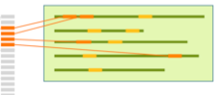
Hash tables
Hash table = index of all locations of a k-mer in a sequence.
k-mer = short fixed sequence, k nucleotides long.
hash table
reference genome
reference genome
k-mers
Each k-mer entry in the hash stores the genome location(s) where the k-mer can be found.
ATGGAAGTCGCGGAATC
ATGGAAG
TGGAAGT
GGAAGTC
GAAGTCG
AAGTCGC
AGTCGCG
…
Notes:
The hash tables for large mammalian genomes are several Gb in size.
The first fast method is a hash-table. This is a sketch of how it works.
A typical algorithm will SCAN the REFERNCE GENOME base by base,
And record the kmer of length n starting at that base (e.g. 7mers)
It will PUT that kmer into a dictionary, along with a reference of where that kmer was found.
This is an example of the kmer-recording for 7-mers in this “genome”
Typical kmer hash for a mammalian genome is several Gb
THEN for each query sequence read, the algorithm will find the kmers in the read, look up the hash to work out where those kmers are in the gnome, and get an approximate best location of the read.
THEN it will do a careful Smith-waterman of the read in that approximate region to get the full alignment.
It turns out you can hash the genome and do the lookup with the reads (very large mem, but constant cost), or the other way around (lower mem, but variable cost)

Slide 18


Hash tables
To align reads:
Split into k-mers
Look up in the hash table -> possible locations of the read in the genome.
hash table
reference genome
split into k-mers
sequencing reads
Notes:
The hash tables for large mammalian genomes are several Gb in size.

Slide 19
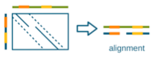
Hash tables
Smith-Waterman is used to extend the possible alignments and find the best one.
hash table
reference genome
split into k-mers
sequencing reads
alignment
Smith-Waterman
Notes:
The hash tables for large mammalian genomes are several Gb in size.

Slide 20
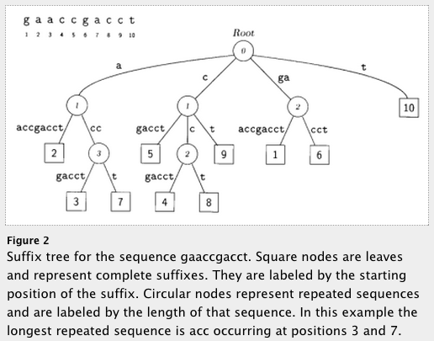
Suffix trees
A suffix tree stores all the suffixes of a string.
It contains the locations where the subsequences exist.
Allows very fast string matching.
But it requires a lot of memory.
genome
The FM index retains the speed of a suffix tree but requires much less memory.
Uses Burrows-Wheeler transform (BWT) sequence instead.
BWT reorders the genome such that sequences that exist multiple times appear together in the data structure.
Flicek and Birney, Nat. Methods 6 (2009) doi.org/10.1038/nmeth.1376
Delcher et al., Nucleic Acids Res. 1 (1999) PMID:10325427
Notes:
Suffix trie (pronounced “try”) is a data structure which allows the whole genome to be indexed: this is a different way of bringing the wrapped-up genome to your query sequences.
Here are a couple of examples of suffix tries – the first one is for a sequence of two characters, the first is the whole seq (CT) and then you clip off the C, and build a second branch.
Similarly, if your whole genome consisted of “GAACCG…T” then you’d first build a path from the whole genome, then clip off the first character and see if you could build a path and so on.
The resulting structure is a compact way of storing a wrapped up genome, along with locations where the subsequences were drawn from.
SO you can walk up to this structure with a read, and chase down the paths, and read off the matching substrings and their positions (the tree stores the ending positions of the suffixes).
So you recover where there was a match + position of the match.
The storage cost of the tree is enormous, so the genome is first subject to a BW transform / FM index to make it compact: THEN the trie is built. And the transition from the original trie to the BW-transformed suffix array is beyond the scope of this talk.
EXAMPLES of aligners which use suffix trees and BW indices include the big two (BWA and BOWTIE2)

Slide 21
Alignment limitations
Sequencing reads are short and the genome is complex.
Low-complexity regions.
High content of repeated sequences (repeat elements, paralogs, etc).
Determining the correct location is hard.
Correctly aligning around indels is hard.
Incorrect SNPs are often added around indels.
Smith-Waterman prefers a SNP over opening a gap.
Tools developed to do a second-pass on the reads and locally realign around indels to ‘correct’ the alignments.
Regions with high density of SNPs.
Some aligners have an upper bound of allowed mismatches.
Notes:
Suffix trie (pronounced “try”) is a data structure which allows the whole genome to be indexed: this is a different way of bringing the wrapped-up genome to your query sequences.
Here are a couple of examples of suffix tries – the first one is for a sequence of two characters, the first is the whole seq (CT) and then you clip off the C, and build a second branch.
Similarly, if your whole genome consisted of “GAACCG…T” then you’d first build a path from the whole genome, then clip off the first character and see if you could build a path and so on.
The resulting structure is a compact way of storing a wrapped up genome, along with locations where the subsequences were drawn from.
SO you can walk up to this structure with a read, and chase down the paths, and read off the matching substrings and their positions (the tree stores the ending positions of the suffixes).
So you recover where there was a match + position of the match.
The storage cost of the tree is enormous, so the genome is first subject to a BW transform / FM index to make it compact: THEN the trie is built. And the transition from the original trie to the BW-transformed suffix array is beyond the scope of this talk.
EXAMPLES of aligners which use suffix trees and BW indices include the big two (BWA and BOWTIE2)

Slide 22
Mapping quality
What if there are several possible places in the gnome to align the sequencing read?
Genomes contain many types of repeated sequences.
Transposable elements (40-50% of vertebrate genomes).
Plenty of paralogous genes.
Low complexity sequence.
The aligner assigns a mapping quality to each alignment.

Slide 23
Mapping quality
Mapping quality: measures the confidence of the alignment by considering all possible locations discovered.
p_{cor} = probability alignment is correct
Q = -10 log₁₀ (1-p_{cor})
Q0 read placed with identical score elsewhere = multi-mapped.
Q10 1 in 10 chance the alignment is wrong.
Q20 1 in 100 chance the alignment is wrong.

Slide 24
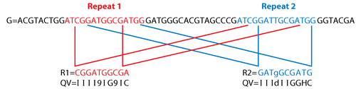
Mapping quality
Mapping quality: measures the confidence of the alignment by considering all possible locations discovered.
p_{cor} = probability alignment is correct
Q = -10 log₁₀ (1-p_{cor})
Q0 read placed with identical score elsewhere = multi-mapped.
Reinert et al., Annu. Rev. Genomics Hum. Genet. 16 (2015) doi.org/10.1146/annurev-genom-090413-025358
Notes:
A repeat with two copies and a single mismatch (underlined)
The read R1 (red) maps perfectly to repeat 1 and with 1 mismatch to repeat 2. It gets mapped to reapeat1 because it has a higher aln score.
Read R2 also maps perfectly to repeat 1 and with 1 mismatch to repeat 2, but the mismatching base is low quality. Thus, the aligner cannot decide if one aln is better than the other. The read is multimapped.

Slide 25
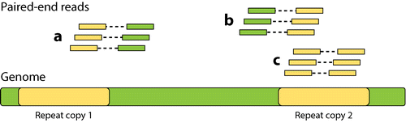
Mapping quality
Mapping quality: measures the confidence of the alignment by considering all possible locations discovered.
One way to lessen the burden of multi-mapping reads is to use paired-end reads.
Reinert et al., Annu. Rev. Genomics Hum. Genet. 16 (2015) doi.org/10.1146/annurev-genom-090413-025358

Slide 26
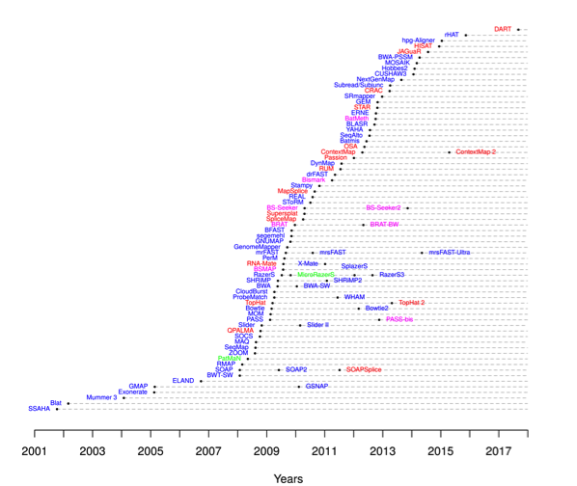
Aligners
There are many aligners available.
Differences in speed and memory usage.
Read the publication and manual.
The default settings might not be appropriate for your data. Consider:
type of data (DNA vs RNA)
penalties for mismatches and indels
handling of multi-mapped reads
read length
mapping paired-end reads
For DNA, minimap2 and bwa are some of the popular choices.
DNA
RNA
Notes:
RNA-seq alignment requires splice-aware algorithms. This will be covered in the RNA-seq module.

Slide 27
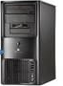
Parallelisation
One HiSeq X10 lane produces 150Gb of data.
BWA-mem aligns 50Mb in 5 CPU minutes.
150Gb / 50Mb = 150x10⁹ / 50x10⁶ = 3x10³ 50Mb chunks per HiSeq X10 lane.
5 min x 3x10³ = 15,000 CPU minutes
= 250 hours = 10.4 days
Solution: use parallel computing.
Split the input into N pieces.
Process each piece in parallel.
Join the results together.
In a cluster with 200 nodes, one lane can be aligned in ~1.25 hrs.
FASTQ
BAM
FASTQ
chunk1
chunk2
chunk3
chunkn
BAM

Slide 28
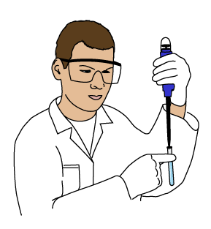
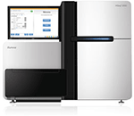
Output files
FASTQ
BAM
library prep
base calling
alignment
sample collection
raw sequencing reads
aligned sequencing reads
sequencing
Sequencing reads are input as FASTQ files.
Alignments are reported as SAM|BAM|CRAM files.

Slide 29
Output files
FASTQ
BAM
library prep
base calling
alignment
sample collection
raw sequencing reads
aligned sequencing reads
sequencing
Sequencing reads are input as FASTQ files.
header
@SEQ_ID GATTTGGGGTTCAAAGCAGTATCGATCAAATAGTAAATCCATTTGTTCAACTCACAGTTT + !''*((((***+))%%%++)(%%%%).1***-+*''))**55CCF>>>>>>CCCCCCC65
sequence
quality

Slide 30
Output files
FASTQ
BAM
library prep
base calling
alignment
sample collection
raw sequencing reads
aligned sequencing reads
sequencing
Aligned reads are stored in SAM/BAM/CRAM files.
SAM
BAM
CRAM
Sequence/Alignment Map format
Unified format for storing read alignments to a reference genome.
Compressed binary equivalent of SAM -> much smaller.
Can be indexed allowing rapid retrieval of alignments from a genomic region.
Uses reference-based compression to reduce file size even further.
Only stores base calls that differ from the reference.
SAMtools provides a set of programs to manipulate (view, sort, index, merge, etc) these files.

Slide 31
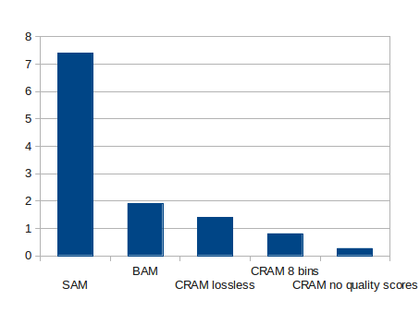
Output files
FASTQ
BAM
library prep
base calling
alignment
sample collection
raw sequencing reads
aligned sequencing reads
sequencing
Aligned reads are stored in SAM/BAM/CRAM files.
With the amount of data generated by current technologies, even modest reductions in file size are very important.
Most tools now support CRAM files.
SAMtools, Picard, BEDtools…
file size (GB)

Slide 32
SAM format
Header section: information is encoded by TAG:VALUE entries.
header
@HD VN:1.5 SO:coordinate
@SQ SN:1 LN:195471971
@SQ SN:10 LN:130694993
@SQ SN:11 LN:122082543
@SQ SN:12 LN:120129022
... ... ...
@SQ SN:JH584292.1 LN:14945
@SQ SN:JH584295.1 LN:1976
@RG ID:1 PL:illumina PU:1 LB:do9029 SM:do9029 CN:CRI
@PG ID:bwa-E39E2AF PN:bwa VN:0.7.12-r1039 CL:bwa samse mm10.fa - wt1.fq
@PG ID:MarkDuplicates PN: MarkDuplicates VN:1.139 CL:MarkDuplicates INPUT=[wt1.bam] OUTPUT=temp.bam METRICS_FILE=metric.txt REMOVE_DUPLICATES=false…
@CO [optional]
reference sequence dictionary
read group
program
comment line
https://samtools.github.io/hts-specs/SAMv1.pdf
Notes:
@HD header line. Version, sorting/grouping of alignments.
@SQ reference sequence dictionary. Sequence name and length. Genome assembly, species...
@RG read group. Barcode identifying the sample. Sequencing centre, date, platform, median insert size...
@PG program. Program name, version, command line.
@CO comment line.

Slide 33
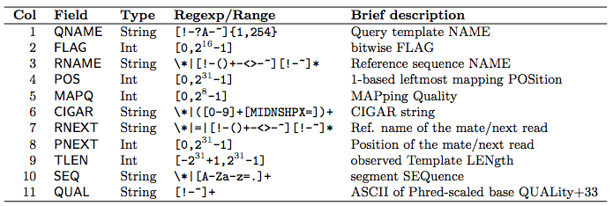
SAM format
Alignment section: 11 mandatory fields; always in the same order.
0 or * if information is unavailable.
https://samtools.github.io/hts-specs/SAMv1.pdf

Slide 34
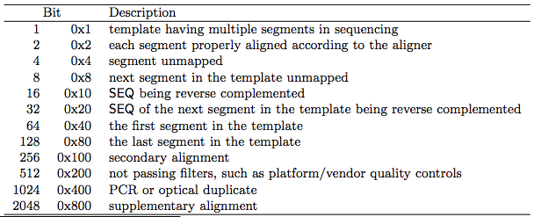
SAM format
Alignment section: 11 mandatory fields; always in the same order.
0 or * if information is unavailable.
Explain SAM flags: https://broadinstitute.github.io/picard/explain-flags.html
https://samtools.github.io/hts-specs/SAMv1.pdf

Slide 35
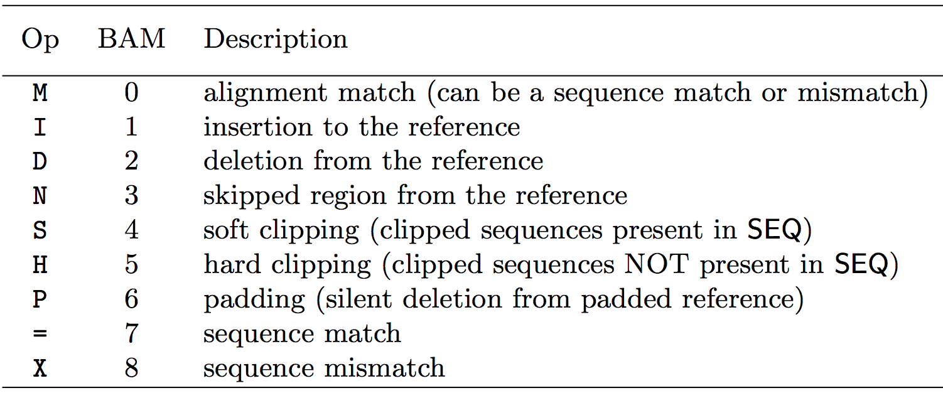
SAM format
Alignment section: 11 mandatory fields; always in the same order.
0 or * if information is unavailable.
12S101M1D36M
https://samtools.github.io/hts-specs/SAMv1.pdf

Slide 36
SAM format
Alignment section: 11 mandatory fields; always in the same order.
0 or * if information is unavailable.
paired-end data information
https://samtools.github.io/hts-specs/SAMv1.pdf

Slide 37
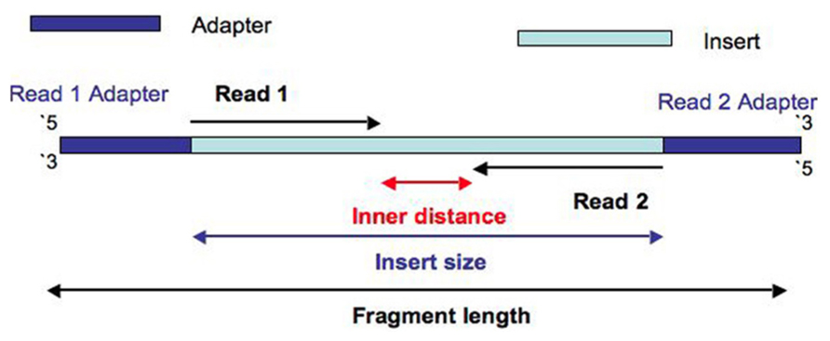
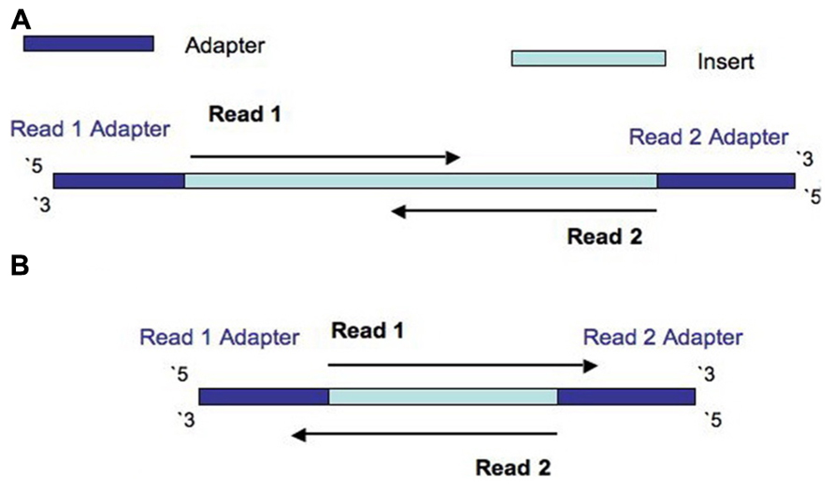
Paired-end data
With paired-end sequencing we only read the ends of the fragment.
If insert size < read1+read2 a fraction of the sequence will be present in both reads.
If insert size > read1+read2 there will be unknown sequence between the two reads.
Both reads from the same fragment have the same name in the FASTQ/BAM files.
If insert size < read1 both reads will have the same sequence plus adapter sequence.
Turner, Front Genet. 30 (2014) doi.org/10.3389/fgene.2014.00005

Slide 38
SAM format
Alignment section: 11 mandatory fields; always in the same order.
0 or * if information is unavailable.
Optional fields encoded as TAG:TYPE:VALUE.
Edit distance, number of total alignments, alignment score, string of mismatching positions, read group, information of mate’s alignment...
ALIGNMENT TAGS:
http://www.samformat.info/sam-format-alignment-tags
MC:mate cigar
MD:string for mismatching positions
NM:edit distance to the reference (no clipping)
AS:aligner’s alignment score
XS:suboptimal alignment score
https://samtools.github.io/hts-specs/SAMv1.pdf

Slide 39
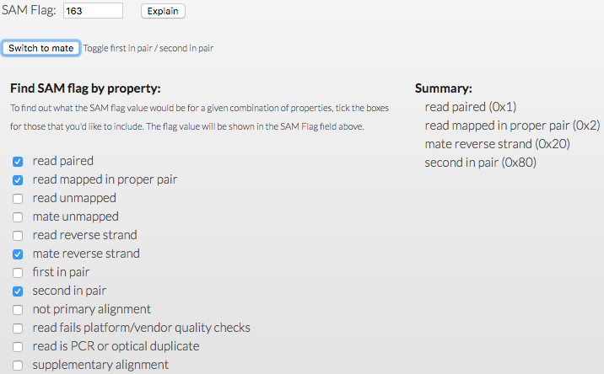
SAM format
flag
1
2
HX8_24050:5:2103:20770:9449 83 7 4189207 0 151M = 4188954 -404 GTTG <JJJ MC:Z:151M MD:Z:151 NM:i:0 AS:i:151 XS:i:151
HX8_24050:5:2103:20770:9449 163 7 4188954 0 151M = 4189207 404 TTGG AAFF MC:Z:151M MD:Z:151 NM:i:0 AS:i:151 XS:i:151
HX8_24050:3:2212:32319:38772 99 7 4188947 0 151M = 4189300 436 ATGG AAAF MC:Z:68S83M MD:Z:151 NM:i:0 AS:i:151 XS:i:151
HX8_24050:3:2212:32319:38772 147 7 4189300 0 68S83M = 4188947 -436 ACAG --7- MC:Z:151M MD:Z:5C10T4T61 NM:i:3 AS:i:68 XS:i:75
read name
two reads with same name => paired-end data
same as in the FASTQ file
samtools allows filtering reads based on flag values
Explain SAM flags: https://broadinstitute.github.io/picard/explain-flags.html
Notes:
Step through each field one by one, so in exercises it becomes automatic.
Qname = fastq match (up to pair)
FLAG: how can they find out what this means? Samtools flags – try it at exercise.
Need to be able to read/understand this.
Read could be in a pair, unpaired, in the wrong orientation etc
MORE importantly, it could be a PCR dup (marked as such) or machine fail. You can samtools view and remove such reads deliberately.
RNAME POS, the important stuff: where the 5’ end of the read starts
MAPQ, CIGAR. MAPQ is an indication of how confident the aligner is that this is the best hit. We have zeros here – what does that mean?
CIGAR – step through the meaning of 151M and 68S83M
RNEXT PNEXT – point at position of the second element of a pair
TLEN: PCR template minus the adapter edges: difference in read-POS + length of a single read (have to do it this way because the POS is always the 5’ end)
SEQ, QUALITY – will discuss map quality shortly, and mappability.
ALIGNMENT TAGS. Look at the SAM spec, but also this cool website. Some aligners put their own specific tags in here, but these are look-upable from the website.
Look at the NM tag, note the mark of the mismatches in the MD field corresponds to the NM:3 tag, but also that it’s indicating mismatches outside the clipping
Note the AS / XS tag: for a MAPQ=0 read, why do you expect XS to be the same as AS ?

Slide 40
SAM format
flag
pos
CIGAR
matePos
SEQ
1
2
3
4
5
6
7
8
9
10
11
HX8_24050:5:2103:20770:9449 83 7 4189207 0 151M = 4188954 -404 GTTG <JJJ MC:Z:151M MD:Z:151 NM:i:0 AS:i:151 XS:i:151
HX8_24050:5:2103:20770:9449 163 7 4188954 0 151M = 4189207 404 TTGG AAFF MC:Z:151M MD:Z:151 NM:i:0 AS:i:151 XS:i:151
HX8_24050:3:2212:32319:38772 99 7 4188947 0 151M = 4189300 436 ATGG AAAF MC:Z:68S83M MD:Z:151 NM:i:0 AS:i:151 XS:i:151
HX8_24050:3:2212:32319:38772 147 7 4189300 0 68S83M = 4188947 -436 ACAG --7- MC:Z:151M MD:Z:5C10T4T61 NM:i:3 AS:i:68 XS:i:75
read name
chr
MAPQ
mateChr
insertSize
QUAL
two reads with same name => paired-end data
same as in the FASTQ file
always the leftmost mapping position
Q0 read placed with identical score elsewhere = multi-mapped.
Q10 1 in 10 chance the alignment is wrong.
Q20 1 in 100 chance the alignment is wrong.
Notes:
Step through each field one by one, so in exercises it becomes automatic.
Qname = fastq match (up to pair)
FLAG: how can they find out what this means? Samtools flags – try it at exercise.
Need to be able to read/understand this.
Read could be in a pair, unpaired, in the wrong orientation etc
MORE importantly, it could be a PCR dup (marked as such) or machine fail. You can samtools view and remove such reads deliberately.
RNAME POS, the important stuff: where the 5’ end of the read starts
MAPQ, CIGAR. MAPQ is an indication of how confident the aligner is that this is the best hit. We have zeros here – what does that mean?
CIGAR – step through the meaning of 151M and 68S83M
RNEXT PNEXT – point at position of the second element of a pair
TLEN: PCR template minus the adapter edges: difference in read-POS + length of a single read (have to do it this way because the POS is always the 5’ end)
SEQ, QUALITY – will discuss map quality shortly, and mappability.
ALIGNMENT TAGS. Look at the SAM spec, but also this cool website. Some aligners put their own specific tags in here, but these are look-upable from the website.
Look at the NM tag, note the mark of the mismatches in the MD field corresponds to the NM:3 tag, but also that it’s indicating mismatches outside the clipping
Note the AS / XS tag: for a MAPQ=0 read, why do you expect XS to be the same as AS ?

Slide 41
SAM format
flag
pos
CIGAR
matePos
SEQ
1
2
3
4
5
6
7
8
9
10
11
optional tags
HX8_24050:5:2103:20770:9449 83 7 4189207 0 151M = 4188954 -404 GTTG <JJJ MC:Z:151M MD:Z:151 NM:i:0 AS:i:151 XS:i:151
HX8_24050:5:2103:20770:9449 163 7 4188954 0 151M = 4189207 404 TTGG AAFF MC:Z:151M MD:Z:151 NM:i:0 AS:i:151 XS:i:151
HX8_24050:3:2212:32319:38772 99 7 4188947 0 151M = 4189300 436 ATGG AAAF MC:Z:68S83M MD:Z:151 NM:i:0 AS:i:151 XS:i:151
HX8_24050:3:2212:32319:38772 147 7 4189300 0 68S83M = 4188947 -436 ACAG --7- MC:Z:151M MD:Z:5C10T4T61 NM:i:3 AS:i:68 XS:i:75
read name
chr
MAPQ
mateChr
insertSize
QUAL
two reads with same name => paired-end data
same as in the FASTQ file
always the leftmost mapping position
MC:mate cigar
MD:string for mismatching positions
NM:edit distance to the reference AS:alignment score
XS:suboptimal alignment score
Q0 read placed with identical score elsewhere = multi-mapped.
Q10 1 in 10 chance the alignment is wrong.
Q20 1 in 100 chance the alignment is wrong.
Notes:
Step through each field one by one, so in exercises it becomes automatic.
Qname = fastq match (up to pair)
FLAG: how can they find out what this means? Samtools flags – try it at exercise.
Need to be able to read/understand this.
Read could be in a pair, unpaired, in the wrong orientation etc
MORE importantly, it could be a PCR dup (marked as such) or machine fail. You can samtools view and remove such reads deliberately.
RNAME POS, the important stuff: where the 5’ end of the read starts
MAPQ, CIGAR. MAPQ is an indication of how confident the aligner is that this is the best hit. We have zeros here – what does that mean?
CIGAR – step through the meaning of 151M and 68S83M
RNEXT PNEXT – point at position of the second element of a pair
TLEN: PCR template minus the adapter edges: difference in read-POS + length of a single read (have to do it this way because the POS is always the 5’ end)
SEQ, QUALITY – will discuss map quality shortly, and mappability.
ALIGNMENT TAGS. Look at the SAM spec, but also this cool website. Some aligners put their own specific tags in here, but these are look-upable from the website.
Look at the NM tag, note the mark of the mismatches in the MD field corresponds to the NM:3 tag, but also that it’s indicating mismatches outside the clipping
Note the AS / XS tag: for a MAPQ=0 read, why do you expect XS to be the same as AS ?

Slide 42
NGS read alignment
Introduction to read alignment.
Main methods and aligners.
Visualisation of aligned reads.
NGS workflows, QC and BAM improvement.

Slide 43
Visualisation of alignments
Once data is aligned we can perform downstream analyses.
Variant calling (genome/exome DNA-seq).
Peak calling (ChIP-seq, ATAC-seq).
Differential expression (RNA-seq).
It is important to see the alignments.
Verify that the alignment was successful.
Detect artefacts or specific problems with the data.

Slide 44
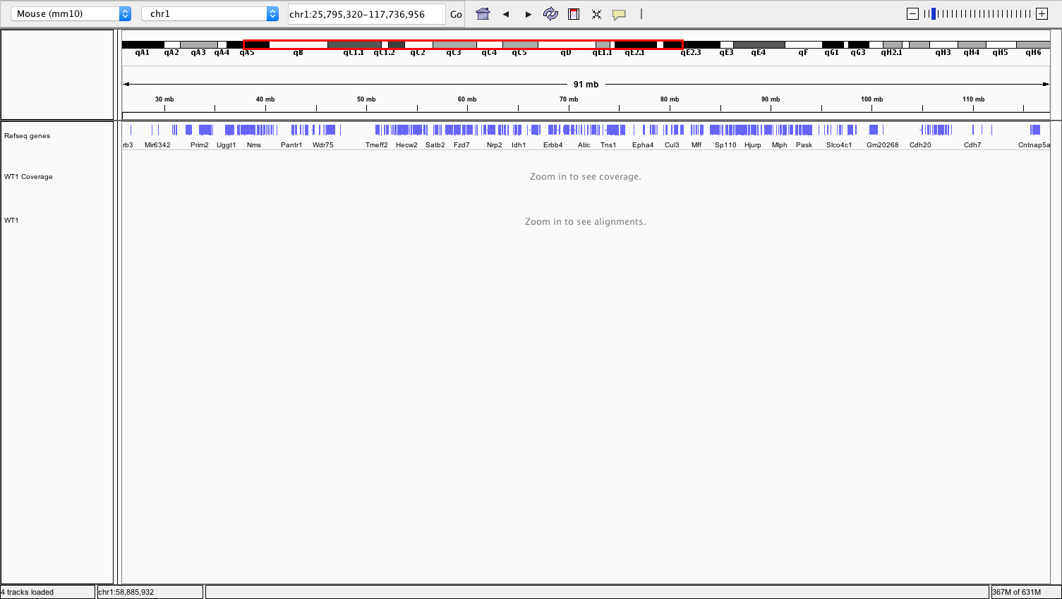
Integrative Genomics Viewer (IGV)
reference genome
genomic location
zoom
make sure you are using the correct assembly!
coverage track
features track
sample track
alignments view
http://software.broadinstitute.org/software/igv/

Slide 45
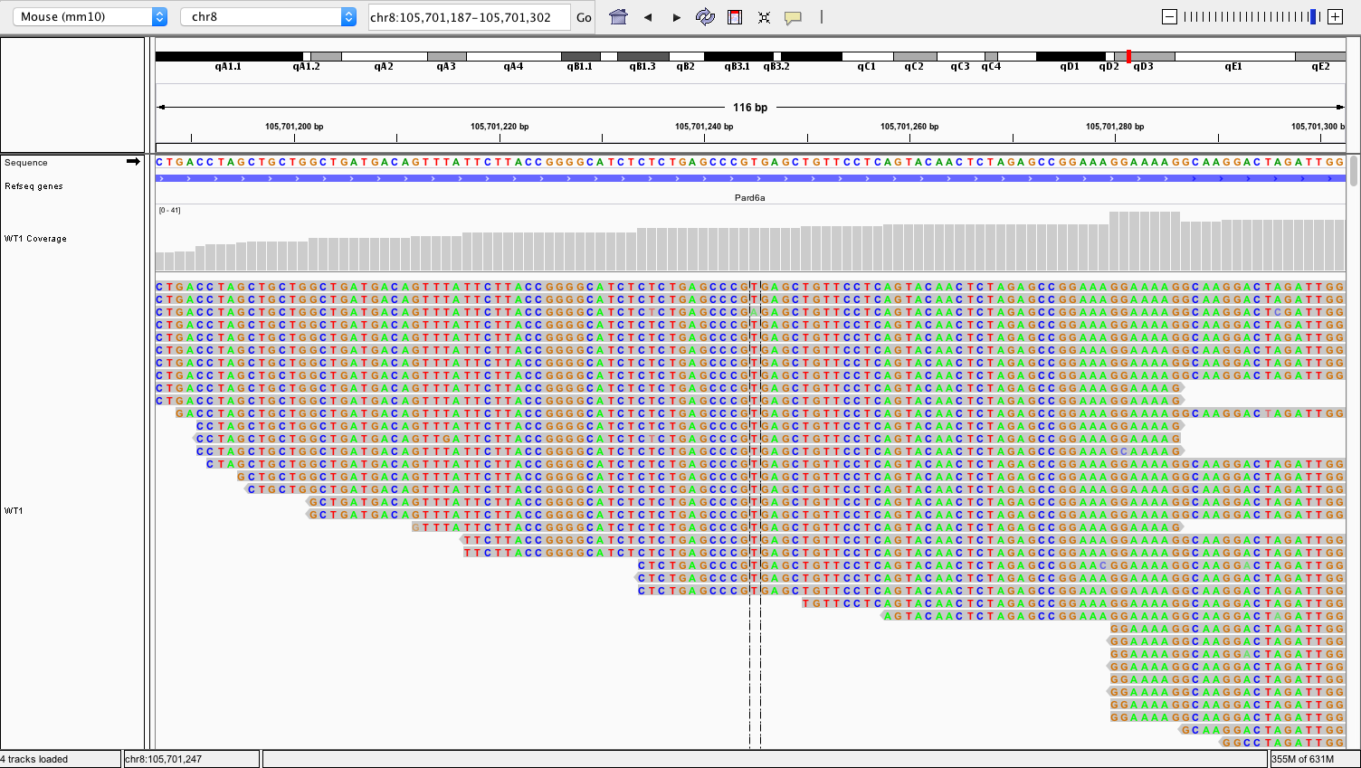
Integrative Genomics Viewer (IGV)
reference genome
coverage track
alignments
http://software.broadinstitute.org/software/igv/

Slide 46
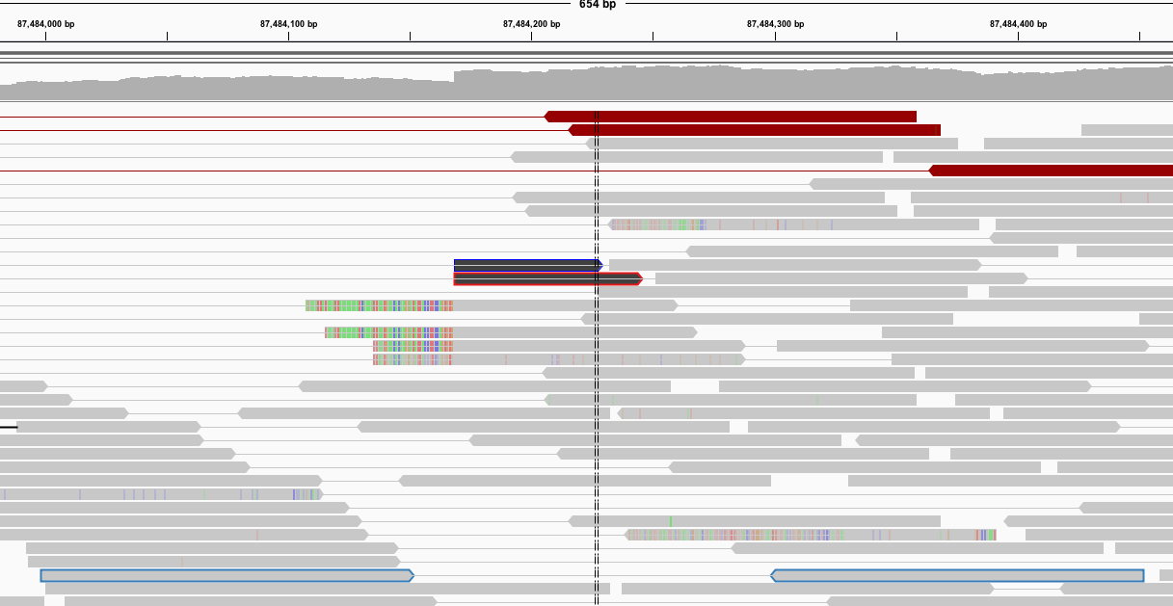
Integrative Genomics Viewer (IGV)
matching bases are shown in grey and only mismatches are coloured
grey lines connect mate pairs
http://software.broadinstitute.org/software/igv/
Notes:
READ PAIRS.
We have switched off base-colouring when there’s a match, and we’ve zoomed out slightly.
Notice that most reads are pretty ‘grey’ which means that they just match the reference sequence.
Key points:
Look at the SAMTOOLS VIEW output at the bottom. You see two reads in a pair, insert size = TLEN 453bp (tail to tail distance), with CIGARS indicating no indels (no I, no D, no clipping)
And this is what IGV is showing in the blue outlined reads:
Look at the blue reads at the bottom. Notice they are GREY, indicating seq match at all points to the reference.
PAIR: Notice they have been joined by a line indicating they are part of a pair.
This pair is not interesting (unless the read-depth is interesting):
The interesting things happen when there is a DISCREPANCY between the reference and the sequence presented by the read.

Slide 47
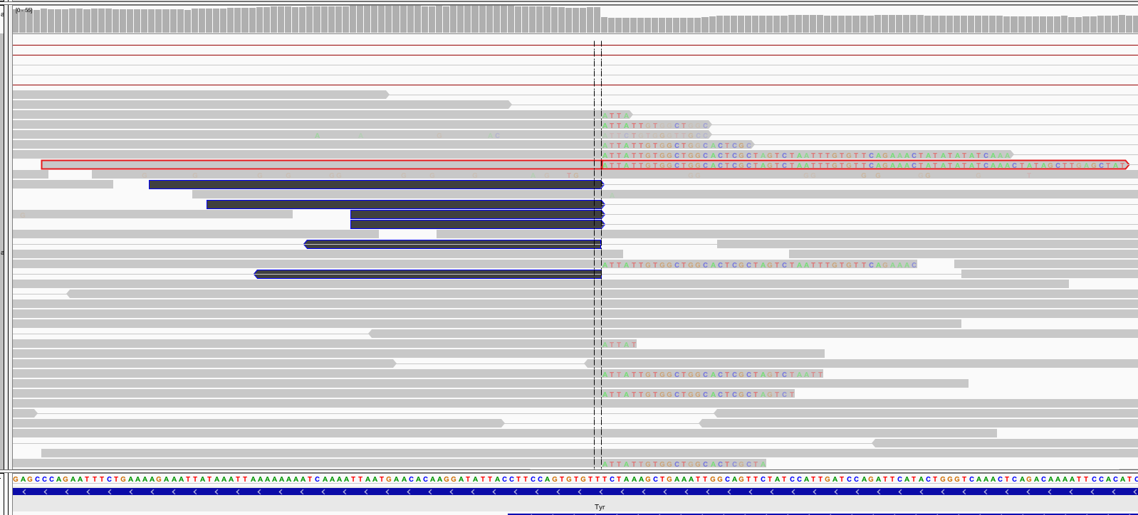
Integrative Genomics Viewer (IGV)
soft-clipped bases do not align
http://software.broadinstitute.org/software/igv/

Slide 48
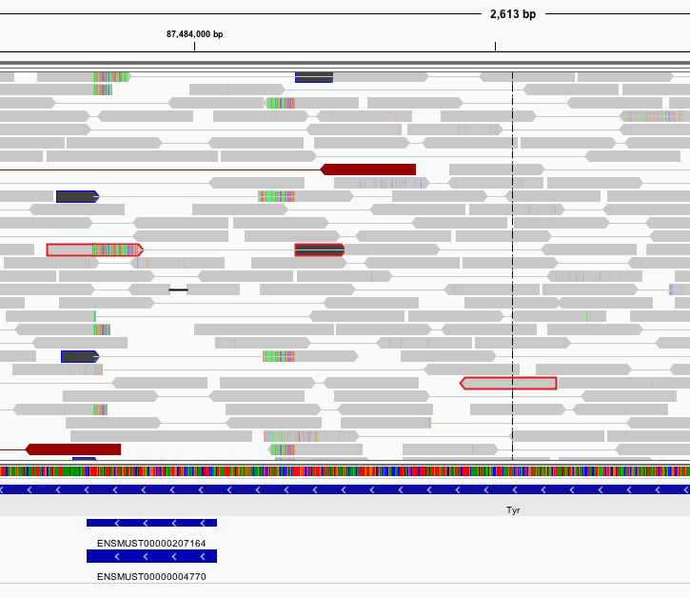
Integrative Genomics Viewer (IGV)
The left read has 78M and then is softclipped.
The right read aligns perfectly.
The middle read alignment is the ‘right half’ of the left read. It is hard-clipped and marked as ‘secondary’ (see flags).
this read has three alignments
http://software.broadinstitute.org/software/igv/
Notes:
In fact, if you look carefully for all aligned locations of this read pair by zooming out, you will find THREE lines.
First line = aligned first half of read1 + softclipped second
Third line = Read 2, which is boring.
This is the usual read pair.
Second line = aligned second half of read1. Notice how the aligner has HARD CLIPPED the beginning of the read away and marked it ‘supplementary’
See red-outlined reads in the IGV which indicate all this.
Notice that it sort of messed up the read-pairing markup.

Slide 49
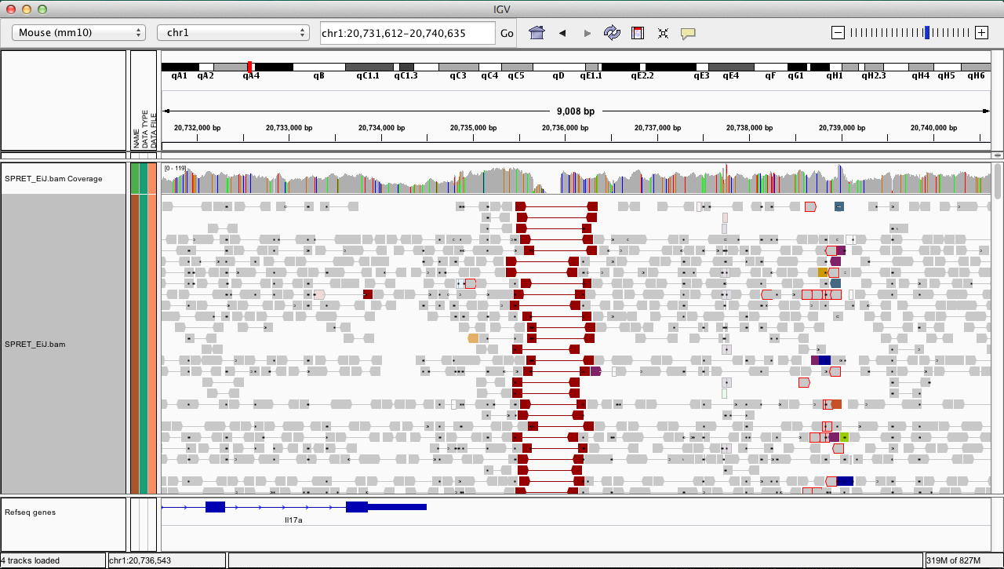
Viewing reads as pairs
http://software.broadinstitute.org/software/igv/
Notes:
IT REALLY HELPS to VIEW READS AS PAIRS
If you zoom out slightly and view the reads as pairs, then you can see that there are pairs which span the deletion.

Slide 50
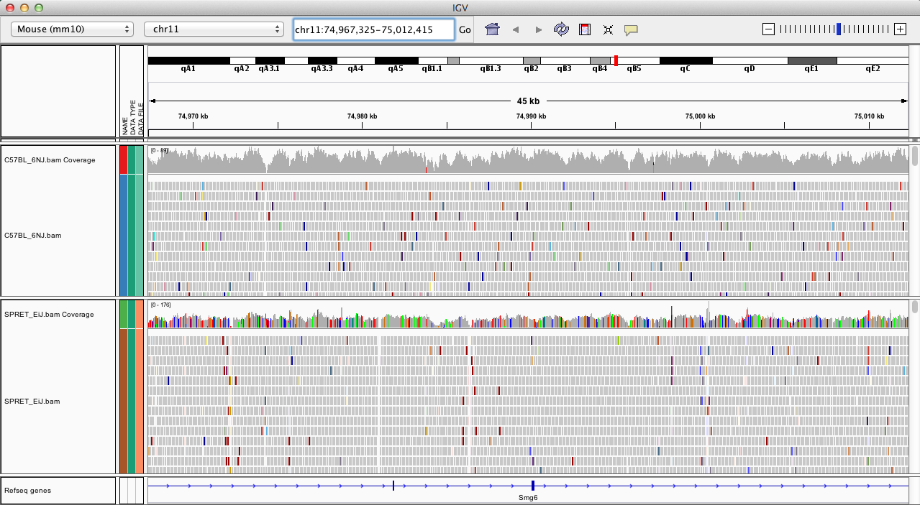
Integrative Genomics Viewer (IGV)
You can view multiple samples at the same time.
http://software.broadinstitute.org/software/igv/

Slide 51
NGS read alignment
Introduction to read alignment.
Main methods and aligners.
Visualisation of aligned reads.
NGS workflows, QC and BAM improvement.

Slide 52
A typical NGS workflow
NGS experiments often have tens to hundreds/thousands of samples.
to increase depth
Sometimes a sample is split across several libraries.
NA3484
NA8746
sample merge
BAM
BAM
BAM
Often each library is split across multiple lanes.
library merge
freeze
BAM
BAM
BAM
…
BAM
BAM
to mitigate batch effects; protect against run failures
bam improvement
BAM
BAM
BAM
…
BAM
BAM
post-alignment QC
alignment
FASTQ
FASTQ
FASTQ
…
FASTQ
FASTQ
Notes:
FIRST:
TYPICAL NGS EXPERMIENTS ARE DONE AT SCALE: there may be 100s of samples.
That needs a coordinated workflow, driven by planned software to bring it reliably together.
The alignment we were discussing is just the first part of that.
Moreover, in that workflow,
A sequencing plan might:
Split a sample across multiple libraries – this happens sometimes
And split a library across multiple lanes - that happens A LOT.

Slide 53
Post-alignment QC
Several useful metrics to assess the quality of the data and alignments produced:
Mapping rate (should be > 90%).
Duplication rate.
GC content vs read depth.
Fragment size distribution.
Indels by cycle.
Samtools produces diagnostic plots.
samtools stats my_aligned_reads.bam > stats.txt
plot-bamstats stats.txt
http://www.htslib.org/doc/samtools-1.6.html
Notes:
POST ALIGN QC.
ONE way of getting post-alignment metrics is to run samtools stats – and you can do this afterwards in the lab.
It will produce many different stats in a file, which you can graph. You’ve been stepped through those by Petr this morning, so I’ll briefly summarise the measures …

Slide 54
A typical NGS workflow
NGS experiments often have tens to hundreds/thousands of samples.
to increase depth
Sometimes a sample is split across several libraries.
NA3484
NA8746
sample merge
BAM
BAM
BAM
Often each library is split across multiple lanes.
library merge
freeze
BAM
BAM
BAM
…
BAM
BAM
for variant calling
to mitigate batch effects; protect against run failures
bam improvement
BAM
BAM
BAM
…
BAM
BAM
post-alignment QC
alignment
FASTQ
FASTQ
FASTQ
…
FASTQ
FASTQ
Notes:
FIRST:
TYPICAL NGS EXPERMIENTS ARE DONE AT SCALE: there may be 100s of samples.
That needs a coordinated workflow, driven by planned software to bring it reliably together.
The alignment we were discussing is just the first part of that.
Moreover, in that workflow,
A sequencing plan might:
Split a sample across multiple libraries – this happens sometimes
And split a library across multiple lanes - that happens A LOT.

Slide 55
BAM improvement
Variant calling relies on the quality score of each base to distinguish sequencing errors from true polymorphisms.
Base quality = chance that the the base call is incorrect.
Phred values (log scale).
Q10 = 1 in 10 chance the base call is incorrect.
Q20 = 1 in 100 chance the base call is incorrect.
Base quality scores produced by a sequencer can be influenced by systematic technical error.
They can vary with sequence context, position in read, etc.
Therefore, quality scores need to be recalibrated.
BQSR = base quality score recalibration.

Slide 56
Base recalibration
Remove all known variants (dbSNP, 1000G, etc.)
Assume all other mismatches are sequencing errors.
Infer the mean observed (empirical) error rate for bins:
Position of base in read (from 1 to read length).
Dinucleotide sequence context (AA, AT, …, CA, CT).
Empirical rate = number of mismatches / total number in bin.
Compare empirical rate to reported sequencer base quality in each of these categories and derive the adjustment for each.
https://gatkforums.broadinstitute.org/gatk/discussion/44/base-quality-score-recalibration-bqsr

Slide 57
Base recalibration
Example:
The sequencer reports Q25 base calls for a “T” in context “AT”.
After alignment, we can see that a “T” in context “AT” actually mismatches the reference 1 in 100 times.
The base quality should be Q20.
Adjustment => for every “T” in context “AT” subtract 5 from their base quality.
NOTE: requires a reference genome and a catalogue of variable sites.
https://gatkforums.broadinstitute.org/gatk/discussion/44/base-quality-score-recalibration-bqsr

Slide 58
Base recalibration effects
original BAM
recalibrated BAM
10
5
0
-5
-10
10
5
0
-5
-10
empirical – reported quality
-150
-100
-50
0
50
100
150
-150
-100
-50
0
50
100
150
cycle
cycle
10
5
0
-5
-10
10
5
0
-5
-10
empirical – reported quality
AA
AG
CA
CG
GA
GG
TA
TG
AA
AG
CA
CG
GA
GG
TA
TG
dynucleotide
dynucleotide
https://gatkforums.broadinstitute.org/gatk/discussion/44/base-quality-score-recalibration-bqsr

Slide 59
A typical NGS workflow
NGS experiments often have tens to hundreds/thousands of samples.
to increase depth
Sometimes a sample is split across several libraries.
NA3484
NA8746
sample merge
BAM
BAM
BAM
library deduplication
Often each library is split across multiple lanes.
library merge
freeze
BAM
BAM
BAM
…
BAM
BAM
to mitigate batch effects; protect against run failures
bam improvement
BAM
BAM
BAM
…
BAM
BAM
post-alignment QC
alignment
FASTQ
FASTQ
FASTQ
…
FASTQ
FASTQ
Notes:
FIRST:
TYPICAL NGS EXPERMIENTS ARE DONE AT SCALE: there may be 100s of samples.
That needs a coordinated workflow, driven by planned software to bring it reliably together.
The alignment we were discussing is just the first part of that.
Moreover, in that workflow,
A sequencing plan might:
Split a sample across multiple libraries – this happens sometimes
And split a library across multiple lanes - that happens A LOT.

Slide 60
Read duplicates
During library prep there is often a PCR amplification step.
This results in duplicate DNA fragments in the final library.
If PCR errors are introduced, these can result in false SNP calls.
Mark duplicates:
Identify read-pairs where the outer ends have the exact same coordinates.
Keep one copy and mark all others as duplicates.
samtools rmdup
Picard/GATK MarkDuplicates
Notes:
This is where duplication comes from:
We should note that PCR amplification is a step in most library preparations.
Therefore, there WILL be duplicate reads in the system, which are not biological.
That’s a problem – it will artificially increase confidence in a variant call.
Once you’ve aligned, though, you can manage this:
Because the PCR dups will have their outer ends at the same genomic position.
So you can spot this and remove all but one read.
There is an expectation that a typical library will have about 5% dups this way, but I see close to 15% often, so I think it’s library / chemistry dependent.

Slide 61
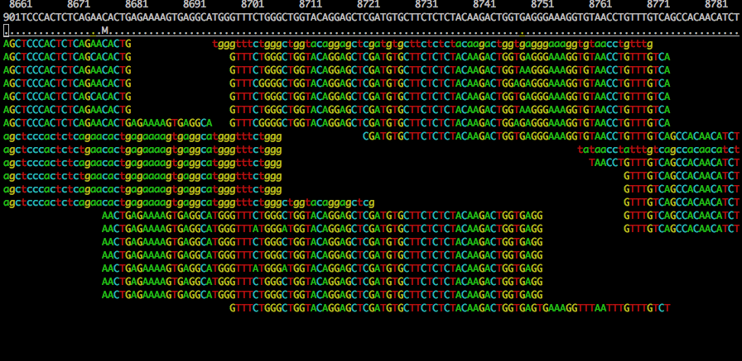
Read duplicates
Notes:
This is where duplication comes from:
We should note that PCR amplification is a step in most library preparations.
Therefore, there WILL be duplicate reads in the system, which are not biological.
That’s a problem – it will artificially increase confidence in a variant call.
Once you’ve aligned, though, you can manage this:
Because the PCR dups will have their outer ends at the same genomic position.
So you can spot this and remove all but one read.
There is an expectation that a typical library will have about 5% dups this way, but I see close to 15% often, so I think it’s library / chemistry dependent.

Slide 62
Read duplicates
Notes:
This is where duplication comes from:
We should note that PCR amplification is a step in most library preparations.
Therefore, there WILL be duplicate reads in the system, which are not biological.
That’s a problem – it will artificially increase confidence in a variant call.
Once you’ve aligned, though, you can manage this:
Because the PCR dups will have their outer ends at the same genomic position.
So you can spot this and remove all but one read.
There is an expectation that a typical library will have about 5% dups this way, but I see close to 15% often, so I think it’s library / chemistry dependent.

Slide 63
The exercise
Align NGS data with bwa.
Mark PCR duplicates with Picard.
Generate and analyse post-alignment QC stats.
Visualise the alignments in IGV.
If you have time
Process data from a library with several lanes of sequencing data.
Merge the results.

